Slide 1
The Computer and It’s Number System
Rajat Rai
Lecture 01
therajatraiofficial@gmail.com

Slide 2
A Chronology of Early Computing
(several BC): abacus used for counting
1614: logarithms discovered (John Napier)
1622: invention of the slide rule (Robert Bissaker)
1642: First mechanical digital calculator (Pascal)
Charles Babbage (U. Cambridge) invents: – 1812: “Difference Engine” – 1833: “Analytical Engine”
1890: First electro-mechanical punched card data processing machine (Hollerith)
1905: Vacuum tube/triode invented (De Forest)

Slide 3
A Chronology of Early Computing
1945: von Neumann drafts “EDVAC” report – design for a stored-program machine –1954: first silicon (junction) transistor (TI)
1959: first integrated circuit (Kilby & Noyce, TI)
1964: IBM System/360, based on ICs.
1971: Intel 4004, first micro-processor (Ted Hoff): – 2300 transistors, 60 KIPS.
1978: Intel 8086/8088 (used in IBM PC).
1980: first VLSI chip (> 100,000 transistors)
Today: ~800M transistors, 45nm, ~3 GHz.

Slide 4
Von Neuman Architecture
1943: ENIAC
Presper Eckert and John Mauchly -- first general electronic computer. (or was it John V. Atanasoff in 1939?)
Hard-wired program -- settings of dials and switches.
1944: Beginnings of EDVAC among other improvements, includes program stored in memory 1945:
John von Neumann wrote a report on the stored program concept, known as the First Draft of a Report on EDVAC The basic structure proposed in the draft became known as the “von Neumann machine” (or model).
A memory, containing instructions and data a processing unit, for performing arithmetic and logical operations a control unit, for interpreting instructions

Slide 5
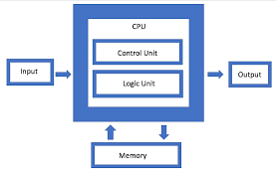

Slide 6
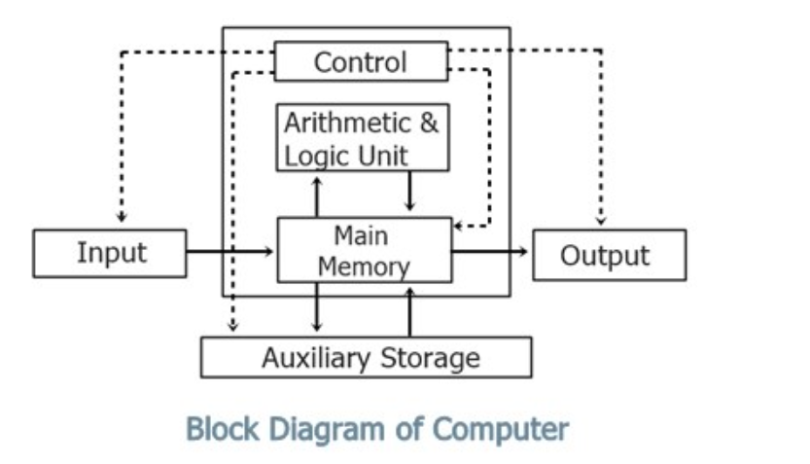
Today’s Computer

Slide 7
The Story of a bit
A bit (Binary digit) is merely 0 or 1.
It is a unit of information since you cannot communicate with anything less than two states.
The use of binary encoding dates back to the 1600s with Jacquard's loom, which created textiles using card templates with holes that allowed needles through.
The nice thing about a bit is that, with only two states, it is easy to embody in physical machinery
Each bit is simply a switch and computers moved from vacuum tubes to transistors for this

Slide 8
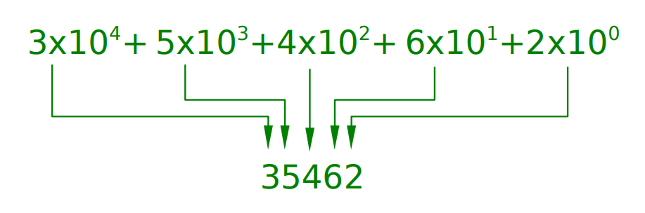
The saga of Decimal Numbers
Most computers count in binary, which we can easily understand from the decimal so ingrained in us

Slide 9
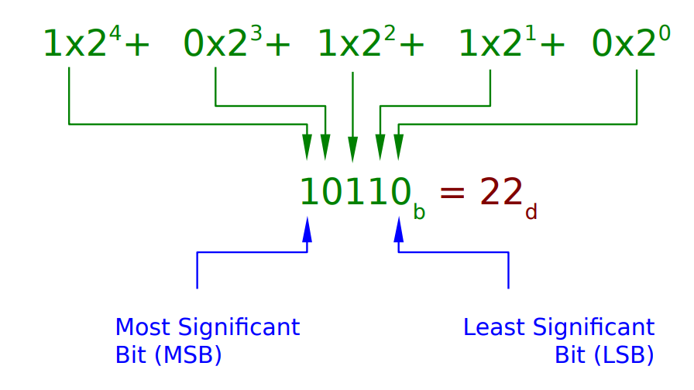
The Binary Number System
Binary is exactly the same, only instead of ten digits/states (0 to 9) we have just two, so the base becomes 2:

Slide 10
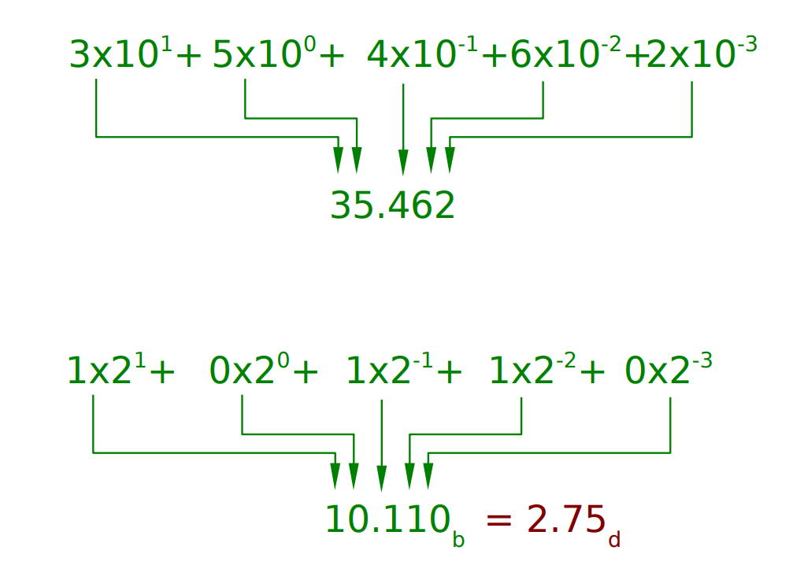
Both works for fractional numbers as well…

Slide 11
Other Common Bases
Higher bases make for shorter numbers that are easier for humans to manipulate. e.g. 6654733_{d} =11001011000101100001101_{b}.
We traditionally choose powers-of-2 bases because this corresponds to whole chunks of binary.
Octal is base-8 (8=23 digits, which means 3 bits per digit)
6654733_{d} =011-001-011-000-101-100-001-101_{b} = 31305415 _{o}
Hexadecimal is base-16 (16=24 digits so 4 bits per digit)
Our ten decimal digits aren't enough, so we add 6 new ones: 0,1,2,3,4,5,6,7,8,9,A,B,C,D,E,F
6654733_{d} =0110-0101-1000-1011-0000-1101_{b} =658B0D_{h}

Slide 12
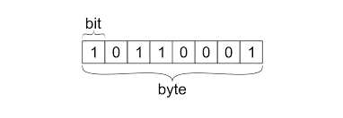
Bytes
A byte was traditionally the number of bits needed to store a character of text
A de-facto standard of 8 bits has now emerged :
256 values :
0 to 255 incl.

Slide 13
Larger Bytes
Strictly the SI units since 1998 are:
Kibibyte (KiB)
1024 bytes (closest power of 2 to 1000)
Mebibyte (MiB)
1,048,576 bytes
Gibibyte (GiB)
1,073,741,824 bytes
but these haven't really caught on so we tend to still use the SI Kilobyte, Megabyte, Gigabyte. This leads to lots of confusion since technically these are multiples of 1,000.

Slide 14
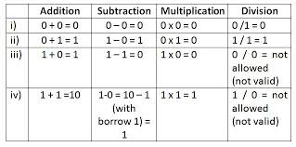
Binary Operations
Conceptually similar to decimal mathematical operations.

Slide 15
Assignment 01 The Computer & it’s number system Deadline: 11:59 pm,19 April 2022
Soft copy submission at : therajatraiofficial@gmail.com
Problem Set 01
To boot up refers to the process of starting a computer from a dead or offline state, thus making it available to perform any computing operation.
Booting up can also be called boot, booting, bootstrapping and system startup.
Do a research and write on what happens inside the computers when we boot up.
Problem Set 02
How your images are stored on your computer, knowing your computer understands only 1’s and 0’s ?
Problem Set 03
Converting binary to decimal
To convert from binary to decimal, you would multiply the digit value by the place value, then add them all together, example
• 110_{b} = ( 1 x 2 ₂) + ( 1 x 2 ₁) + ( 0 x 1 ₀) = 6₁₀
Now convert 1110 _{b} and 101110 _{b} into decimals.

Slide 16
The Computer and It’s Number System
Rajat Rai
Lecture 02
therajatraiofficial@gmail.com

Slide 17
The Decimal Number System
Name
“decem” (Latin) => ten
Characteristics
Ten symbols
0 1 2 3 4 5 6 7 8 9
Positional
2945 ≠ 2495
2945 = (2*10 ³) + (9*10 ²) + (4*10 ¹) + (5*10 ⁰⁾
(Most) people use the decimal number system. Why ?

Slide 18
The Binary Number System
Name
“binarius” (Latin) => two
Characteristics
Two symbols
0 1
Positional
1010B ≠ 1100B
Most (digital) computers use the binary number system Terminology
Bit: a binary digit
Byte: (typically) 8 bits

Slide 19
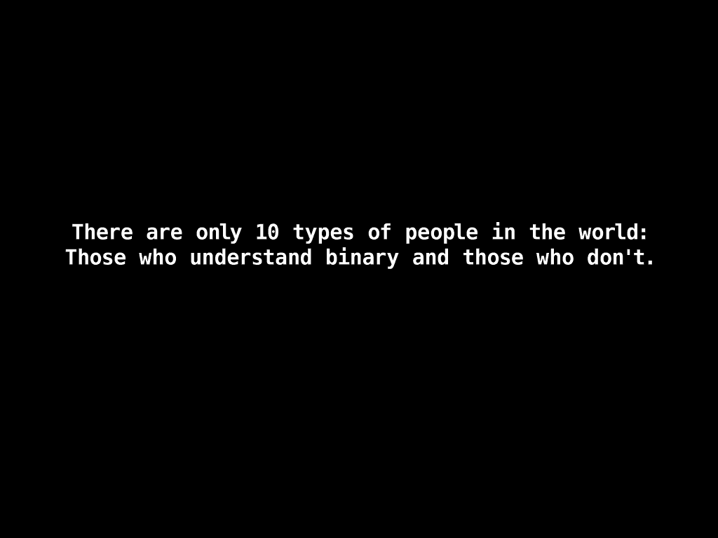

Slide 20
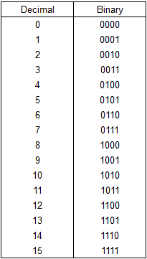
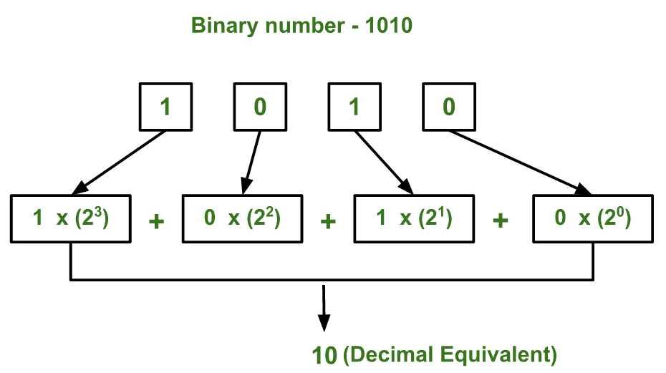
Decimal-Binary Equivalence & Conversion

Slide 21
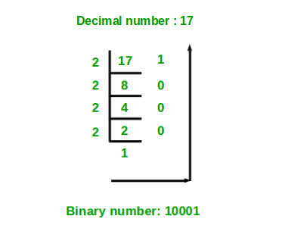
Decimal-Binary Conversion
Repeatedly divide by 2, consider remainder
37 / 2 = 18 R 1
18 / 2 = 9 R 0
9 / 2 = 4 R 1 4 / 2 = 2 R 0
2 / 2 = 1 R 0
1 / 2 = 0 R 1
Read remainder from bottom to top: 100101 _{b}

Slide 22
The Hexadecimal Number System
Name
“hexa” (Greek) => six
“decem” (Latin) => ten Characteristics
Sixteen symbols
0 1 2 3 4 5 6 7 8 9 A B C D E F
Positional
A13DH ≠ 3DA1H
Computer programmers often use the hexadecimal number system.

Slide 23
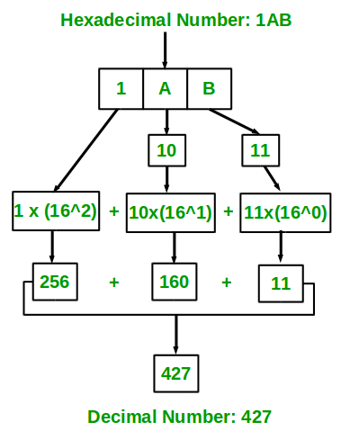
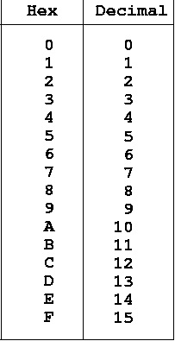
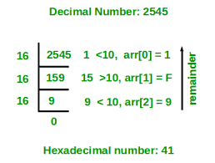
Decimal-Hexadecimal Equivalence & Conversions

Slide 24
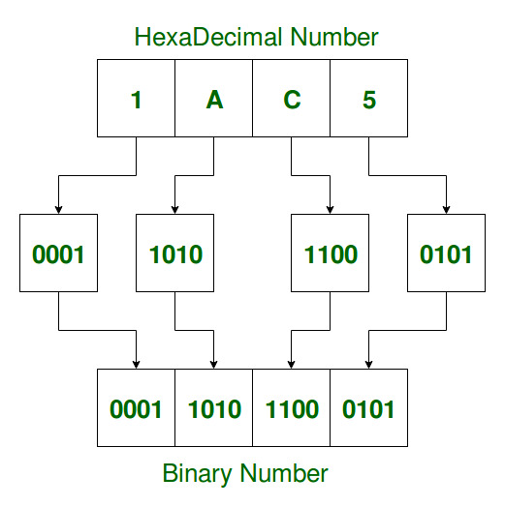
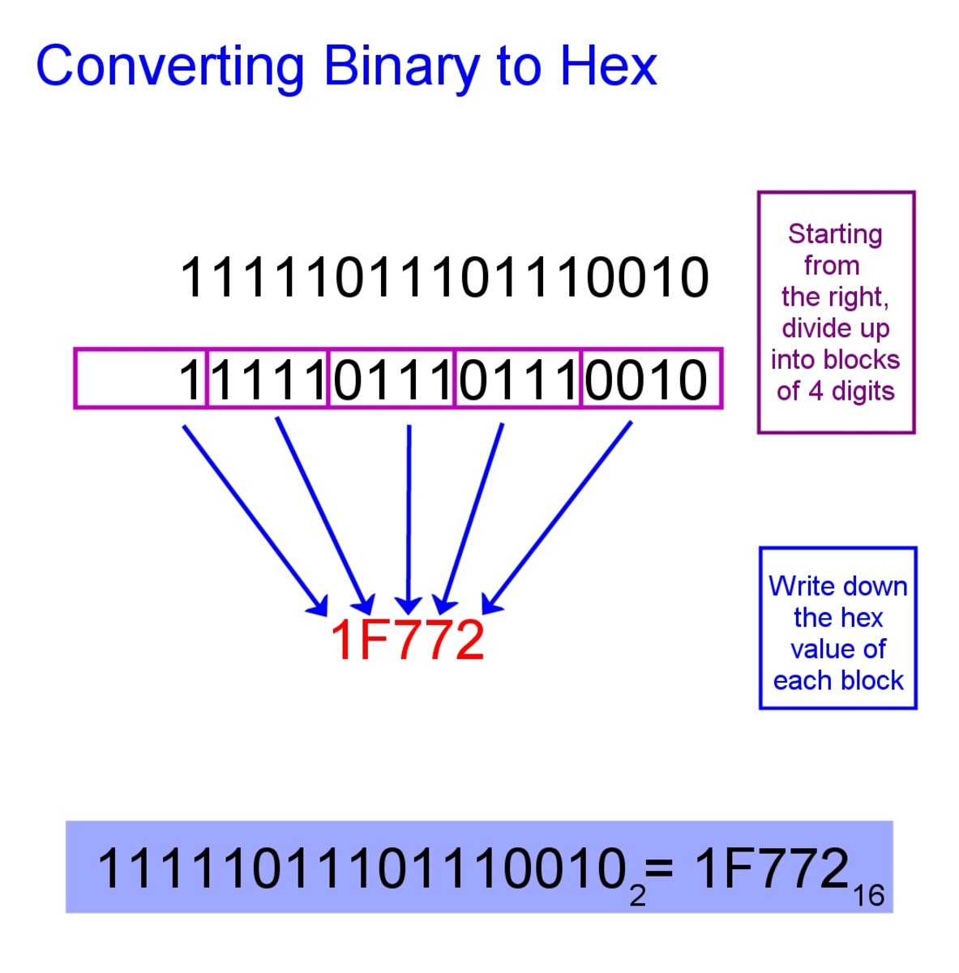
Hexadecimal to Binary and Vice-versa

Slide 25
The Octal Number System
Name
“octo” (Latin) => eight Characteristics
Eight symbols
0 1 2 3 4 5 6 7
Positional
1743O ≠ 7314O
Computer programmers often use the octal number system

Slide 26
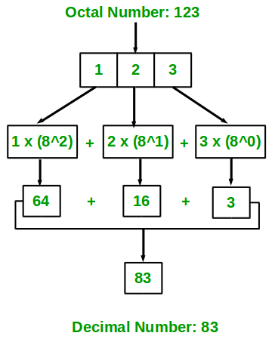
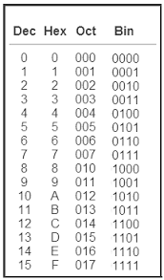
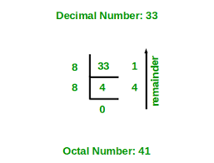
Decimal-Octal Equivalence & Conversions

Slide 27
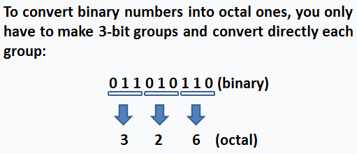
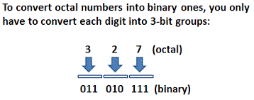
Binary to Octal and Vice-versa

Slide 28
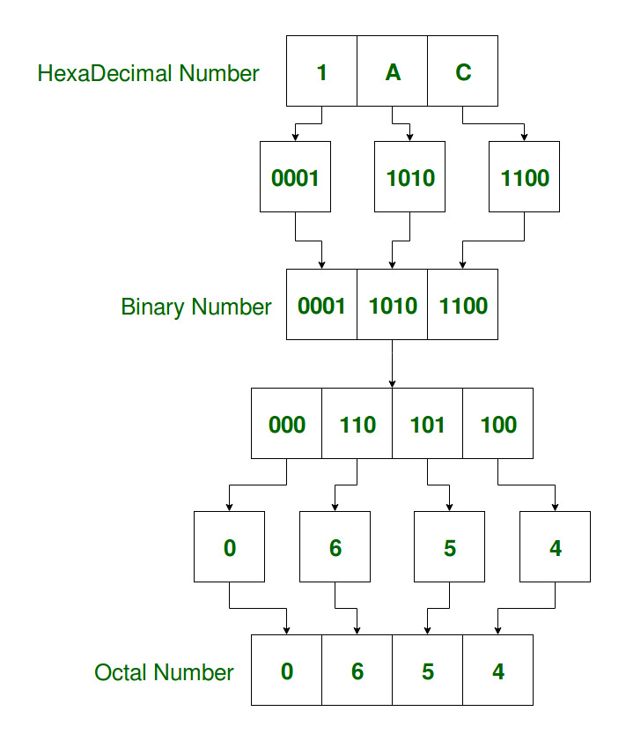
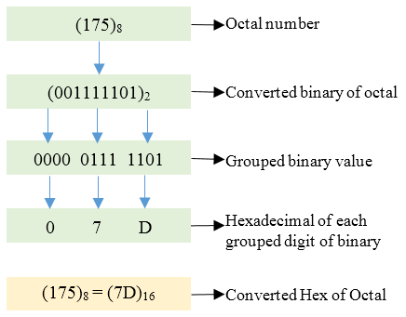
Octal to Hexadecimal & Vice-versa

Slide 29
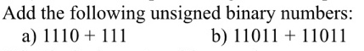
Assignment 02 The Computer & it’s number system Deadline: 11:59 pm,22 April 2022
Soft copy submission at : therajatraiofficial@gmail.com
Problem 01
Problem 02
Convert the binary number 11001 to decimal.
Problem 03
Convert the hexadecimal number 2C to decimal:
Test on Saturday
6:00 PM

